Slide 1
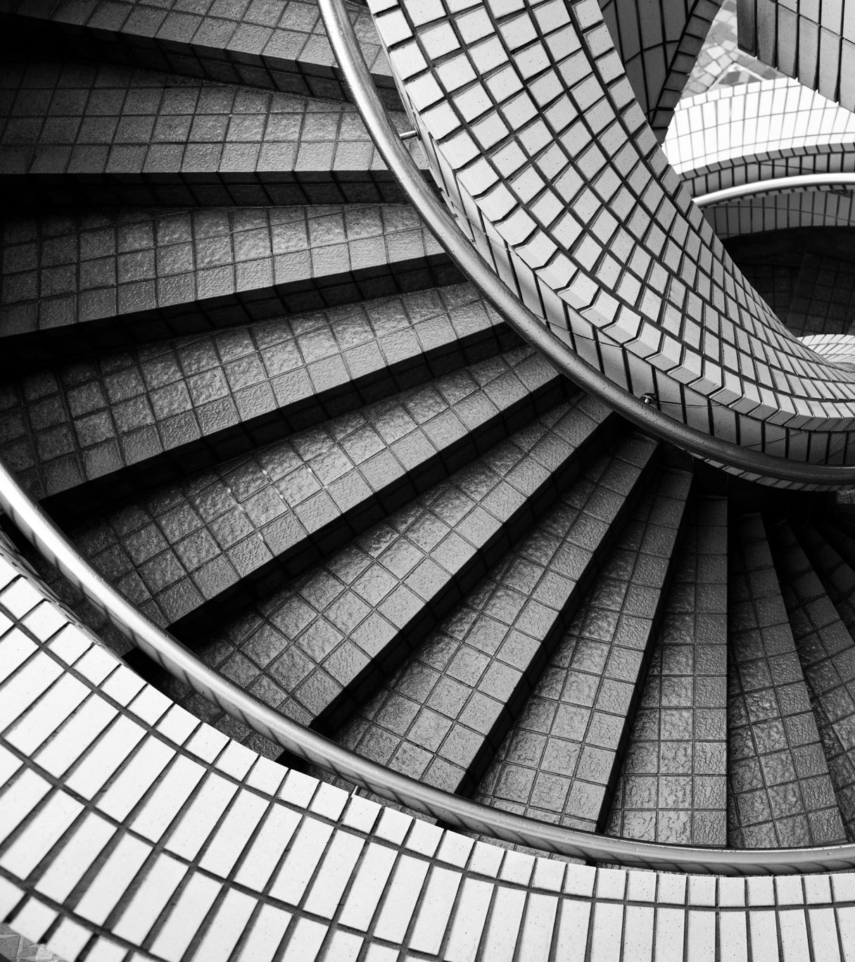
Higher Applications
Error and Tolerance
Notes:
In this 20 minute session I will speed through a series of lessons covering the topic.
I’ll share what I see as the key talking points.

Slide 2
Learning Intentions
Understand the notation of error and tolerance
Estimate the error in mathematical models
Determine whether a process is within tolerance
Notes:
The first of these should be a recap from BGE and National 5
The latter is the new stuff

Slide 3
Terminology
Precision – how precise a number is.
Accuracy – how accurate a number is.
"There are 11,345,324 people in Scotland."
"There are around 5.4 million people in Scotland."
Notes:
This distinction comes up in the spec under errors and tolerance. Students should forever be being asking about how precise their model is, and whether it is accurate to that level of precision.

Slide 4



Notation
Measurement of $5 cm ±2 mm$
No error: $x_{0}$
Absolute errors: $Δx$
Relative errors: $\frac{Δx}{x_{0}}$
Intended measurement: $x_{0}=5 cm$
Absolute error: $Δx=2 mm$
Relative errors: $\frac{Δx}{x_{0}}=\frac{2 mm}{5 cm}=4\%$
Notes:
The notation is not required, but is very useful.
Make a judgement call – can they handle a delta?

Slide 5

Example
Eve weighs a baby as 7.8kg, correct to the nearest 100 grams. Calculate the relative error.
There were 47,750 births in Scotland in 2020. This figure has an error of 3%. Calculate the maximum and minimum number of births for 2020. State the absolute error.
Notes:
These are National 5 level- the only higher part is this language of relative and absolute error.

Slide 6

Task
Leckie Higher Apps - Complete exercise 3A (page 25)
Any National 5 Apps task can be adapted by asking:
  What is $x_{0}$? Find the absolute and relative error.

Slide 7
Estimating Errors
When independent variables are being multiplied or divided, you can estimate the relative error of the dependent variable by adding the relative errors of each independent variable.
This works for small errors.

Slide 8
Example
A room is 4 metres in length by 5 metres in width. These lengths have been rounded to the nearest metre. Jessica says the area of the floor is 20 square metres. Estimate the error.
At a school sports day, Kelsie runs 1500 metres in 06 minutes and 17 seconds.
  Calculate Kelsie’s speed.
  Given that the length of the track is accurate within 3 metres, and the time is accurate to the nearest second, estimate the error in your speed calculation.
Notes:
Get the students to find the answers without errors. Then try different errors within the half metre range.
What’s the biggest error they can create?
Is the adding method for estimating accurate?
Have them create a spreadsheet for different errors.

Slide 9
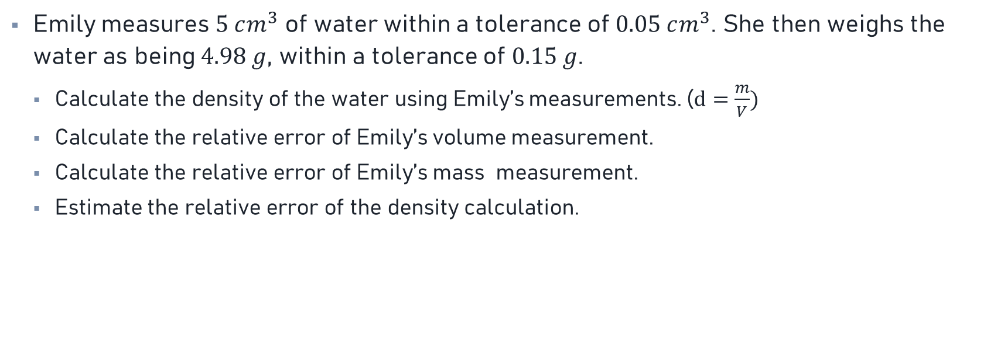
Task
Emily measures $5 cm^{3}$ of water within a tolerance of $0.05 cm^{3}$. She then weighs the water as being $4.98 g$, within a tolerance of $0.15 g$.
  Calculate the density of the water using Emily’s measurements. ($d=\frac{m}{V})$
  Calculate the relative error of Emily’s volume measurement.
  Calculate the relative error of Emily’s mass measurement.
  Estimate the relative error of the density calculation.

Slide 10
Discrete Objects
When sampling, discrete objects will always be counted to the nearest whole number.
Suppose on average there are 8.5 species of flowers in a square metre of woodland. When sampling, you will never count 8.5. You may find 7, or 8, or 9, or some other whole number.
Samples of discrete objects have an error of 0.5.

Slide 11
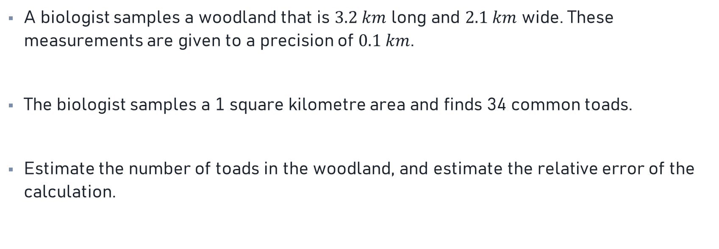
Example
A biologist samples a woodland that is $3.2 km$ long and $2.1 km$ wide. These measurements are given to a precision of $0.1 km$.
The biologist samples a 1 square kilometre area and finds 34 common toads.
Estimate the number of toads in the woodland, and estimate the relative error of the calculation.
Notes:
This is a past paper question – yes they have to know it!

Slide 12
Task
Leckie Higher Apps - Complete exercise 3B (page 28)

Slide 13
Calculating Errors
In models with addition and subtraction of variables, we can calculate the absolute error of the dependent variable by adding the absolute error of the independent variables.
Take into account coefficients of the independent variables!

Slide 14
Calculating Errors
The perimeter of a rectangle is given by P = 2l + 2w. If there is an absolute error of 2 cm in the measurement of the length l and an absolute error of 3 cm in width w, find the absolute error in the perimeter P.
Notes:
This example is straight from the spec, yes they need to be able to do this.
Have the students make up their own rectangle with measurements of their choice. Then have them work out the biggest error they can make given the tolerance of 2cm and 3cm.
You should find that the perimeter will be 10cm out, no matter their choice.
When you aren’t given numbers, make it up. When in doubt, go specific!

Slide 15
Task
Leckie Higher Apps - Complete exercise 3C (page 31)

Slide 16
Tolerance
Often we want to work backwards: Given our output needs to be within tolerance, find the maximum error of the inputs.
Change the subject of the equation to help with this.

Slide 17

Example
Emily is running a 100-metre sprint. Emily wants her average running speed to be $7.5 m/s$ to a tolerance of one tenth of a metre per second. Assuming the running track is exactly 100-metres, estimate the maximum absolute error in the time measurement.

Slide 18
Task
Leckie Higher Apps - Complete exercise 3D (page 33)
Notes:
This contains harder questions such as area formulae and quadratics. Not ruled out on the spec, something to push A students onto!

